Slide 1
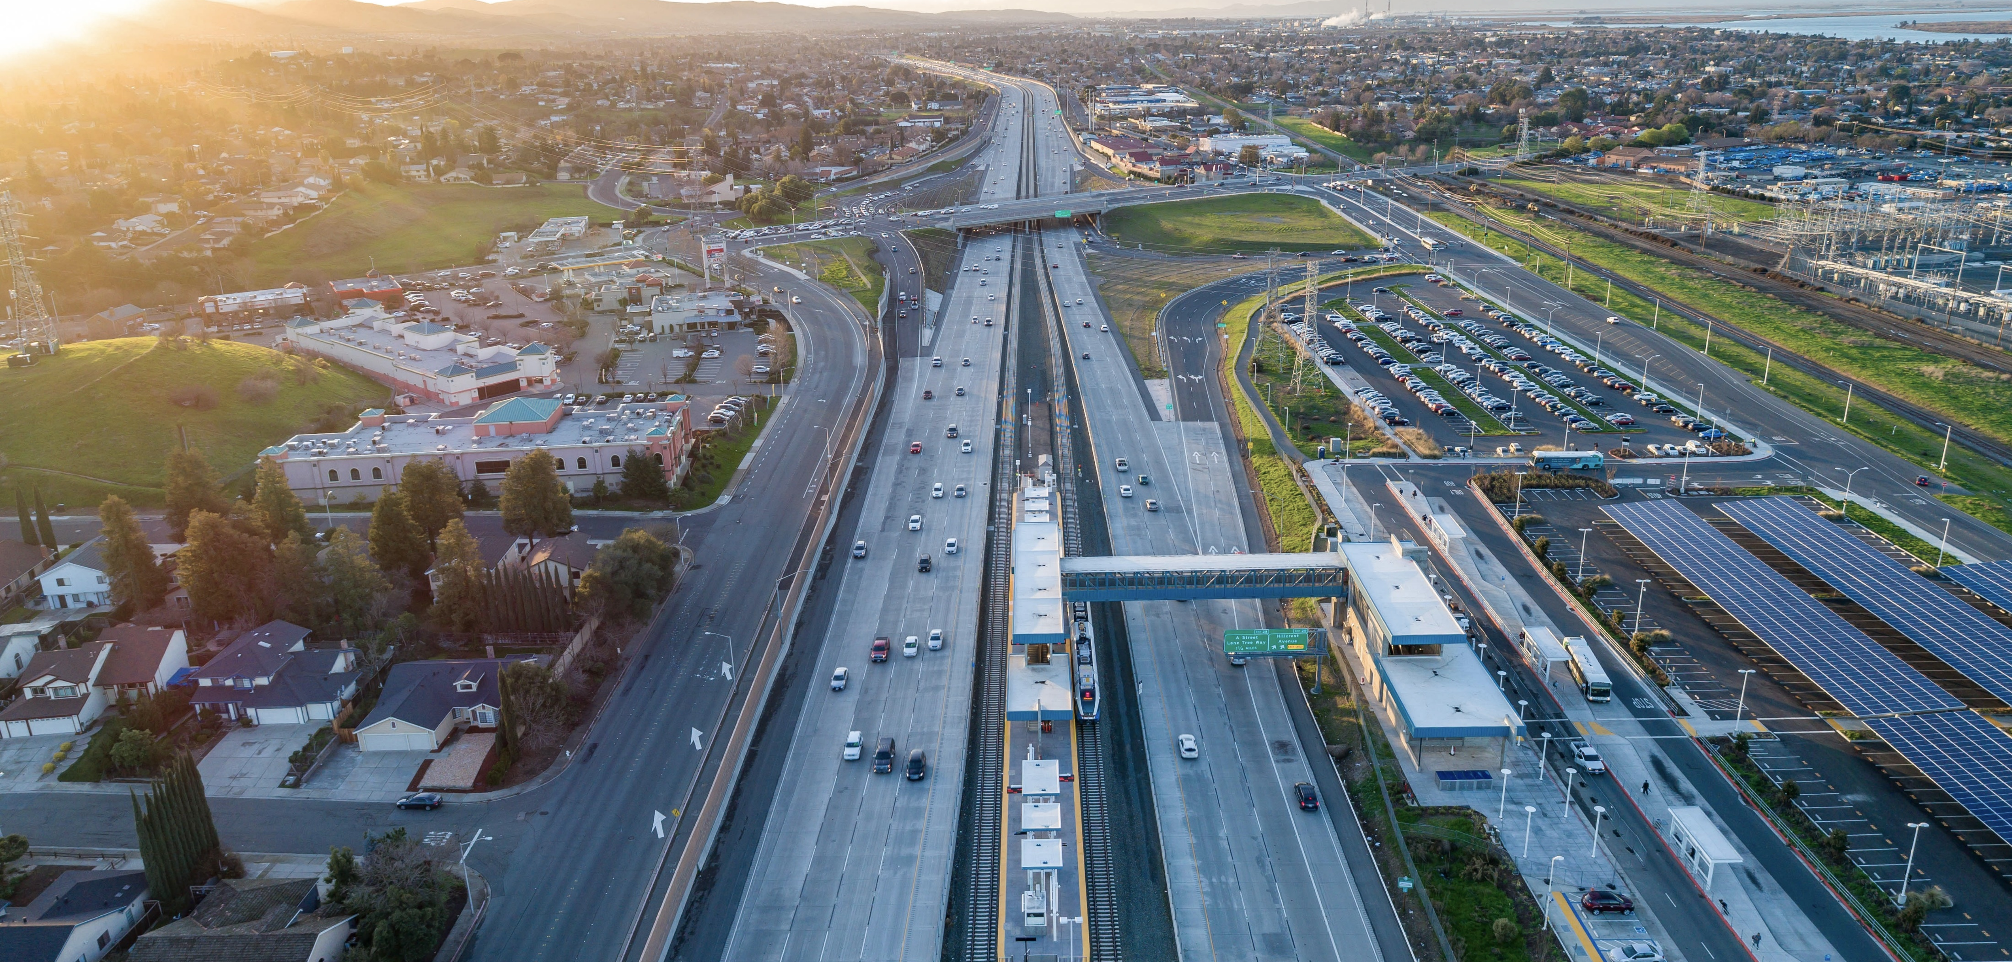


Kickoff Meeting
Kickoff meeting
SB 1 Grant Application & Accessibility
August 27, 2026

Slide 2

Meeting Objectives
SB 1 GRANT APPLICATION & ACCESSIBILITY
By the end of this presentation, participants will:
Understand what PDF remediation is and why it is required.
Learn how remediation impacts the SB 1 application timeline.
Become familiar with available resources.
Identify common accessibility issues before submitting documents.
Learn best practices that save time and reduce revisions.

Slide 3
What is PDF Remediation?
SB 1 GRANT APPLICATION & ACCESSIBILITY
Making Documents Accessible
Accessibility is a legal requirement, not just a best practice.
  Required by federal and state accessibility laws.
  Ensures all electronic documents comply with accessibility requirements (Section 508, Americans with Disabilities Act, and Web Content Accessibility Guidelines).
  Provides equal access to digital information for all users.
  Makes documents readable by assistive technologies, such as screen readers, screen magnifiers, speech recognition software, and alternative input devices.
Remediation is the final step after application content has been reviewed and approved.

Slide 4

How long does remediation take?
SB 1 GRANT APPLICATION & ACCESSIBILITY
How Long Does Remediation Take?
TIME DEPENDS on Document Complexity
Document Type Estimated Processing Time
Simple, well-designed document 30 minutes – 2 hours
Moderate complexity 2 – 5 hours
Large reports, table & graphic heavy, 8 – 10+ hours
100’s of pages
Key Takeaway
Build remediation time into your application schedule.
Last-minute submissions may delay application process

Slide 5
Document "Spice Level"
SB 1 GRANT APPLICATION & ACCESSIBILITY
How Complex Is Your Application?
🟢 Mild
Mostly text
Few images
Simple formatting
🟡 Medium
Standard tables
Charts
Several graphics
🔴 Hot
Complex tables
Forms
Scanned documents
Maps
Multiple appendices
🌶️ 🌶️ Extra Hot 🌶️ 🌶️
Large reports
Engineering drawings
Heavy use of graphics
Hundreds of pages
Use of formulas

Slide 6
Common Remediation Issues
SB 1 GRANT APPLICATION & ACCESSIBILITY
The Most Frequent Problems We See
Complex tables
Missing heading styles
Missing or inaccurate Alt Text
Incorrect reading order
Scanned PDFs without Optical Character Recognition (OCR)
Color contrast
Missing document title or metadata
Lists created manually instead of using list styles
Empty or unnecessary tags

Slide 7
Best Practices
SB 1 GRANT APPLICATION & ACCESSIBILITY
Make Accessibility Easier from the Start
Minimize scanned pages, whenever possible.
  Use digitally signed documents instead of scanned documents.
Apply Microsoft Word Heading Styles.
Use standard fonts and formatting.
  No unconventional font styles.
Add meaningful Alt Text to images, charts, and graphics.
Keep tables simple.
Run an Accessibility Checker before submitting.
Build remediation time into the project schedule.
Submit source files (Word, Excel, PowerPoint) whenever possible.

Slide 8

Edits That “Break” Remediation
SB 1 GRANT APPLICATION & ACCESSIBILITY
Edit Requests that come in after remediation has been completed
Low-Risk Edits
Editing simple text changes
Replacing images
These changes may alter the document's tag structure, reading order, or other accessibility features.

Slide 9

Edits That “Break” Remediation
SB 1 GRANT APPLICATION & ACCESSIBILITY
Edit Requests that come in after remediation has been completed
High-Risk Edits
These almost always warrant another ADA review because they can affect tags, reading order, or semantics:
Adding or modifying tables
Inserting scanned pages
Merging multiple PDFs
Modifying large amounts content
Inserting New Images Without Alternative Text

Slide 10
Planning for Success
SB 1 GRANT APPLICATION & ACCESSIBILITY
Before You Submit
✔ Use the template
✔ Complete the ADA Checklist
✔ Review document formatting
✔ Include source files
✔ Allow sufficient remediation time
✔ Submit early to avoid delays

Slide 11

Questions & Contact Information
SB 1 GRANT APPLICATION & ACCESSIBILITY
Need Assistance?
SB1 Remediation Website
TCCP/SCCP Application Templates and Guidelines
Accessibility PowerPoint Presentation
Remediation "Spice Menu"
Accessibility Review Checklist
ADA Remediation Vendors
Email the PM² Communications Team at
pm2.communications@dot.ca.gov

