Slide 1
Transit Implementation Plan & Focus Groups

Slide 2
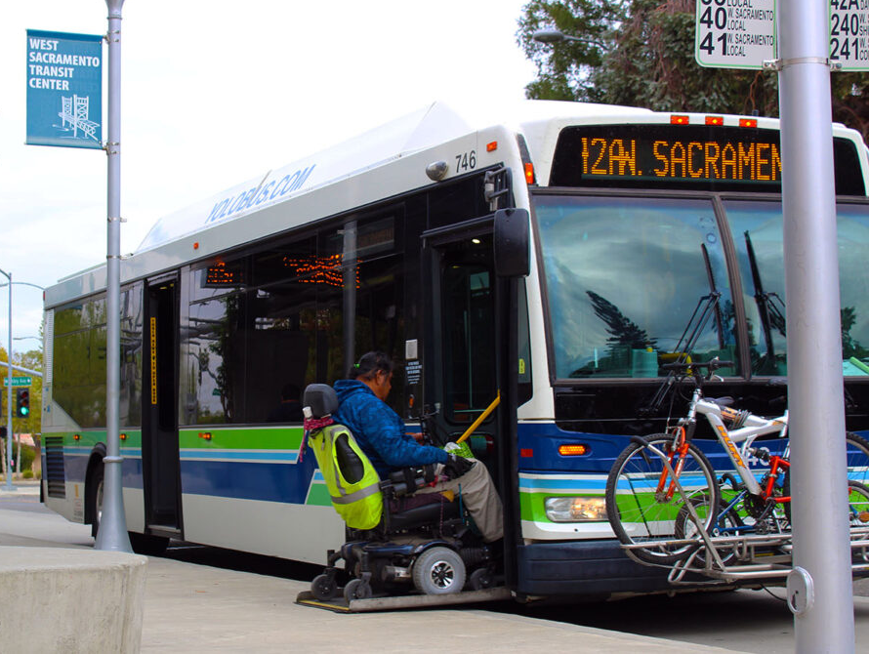
Presentation Details
Transit Implementation Focus Groups – Transit Priority Facilities
Purpose of meeting
Overview of the Transit Implementation Plan
Opportunities to engage
Upcoming Focus Group Meetings
Feedback from these focused discussions will help shape the transit implementation plan.

Slide 3
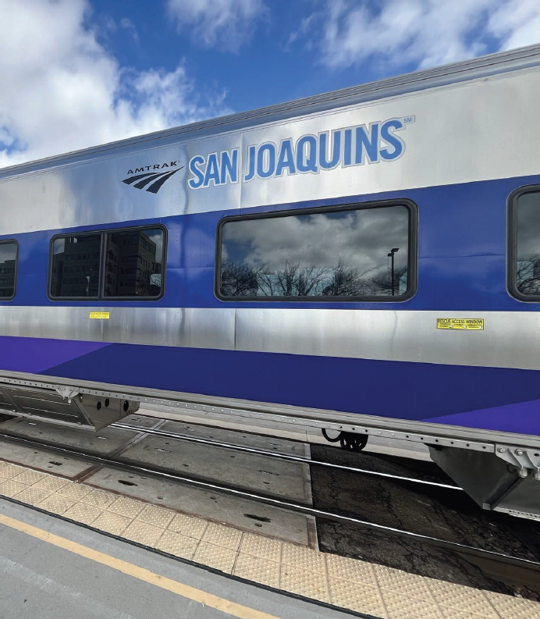
Agenda
Transit Implementation Focus Groups – Transit Priority Facilities
Caltrans Overview
Transit Implementation Plan
Focus Group Meetings

Slide 4
Caltrans Overview
Transit Implementation Focus Groups – Transit Priority Facilities

Slide 5

Caltrans Strategic Plan
Transit Implementation Focus Groups – Transit Priority Facilities
Caltrans Overview
Strategic Plan focuses the Department’s work to increase:
  Safety
  Equity
  Climate action
  Prosperity
  Employee Excellence
Implementing transit facilities on the state highway system furthers these goals.

Slide 6
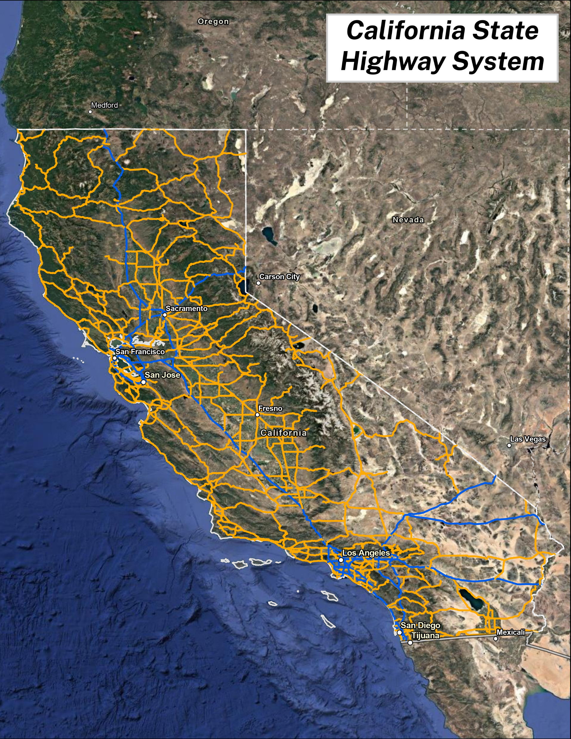
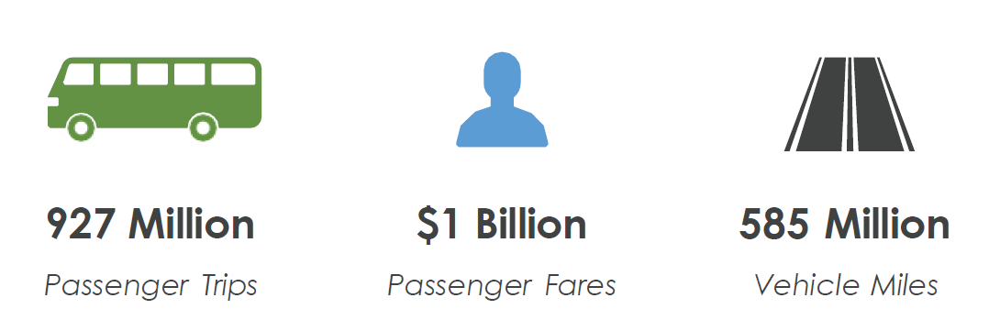
Our Focus:
State Highway System (SHS)
Transit Implementation Focus Groups – Transit Priority Facilities
Caltrans Overview
Orange lines are State Highways
Blue lines are Interstate Routes
TRANSIT TRIPS ON THE STATE HIGHWAY SYSTEM:

Slide 7
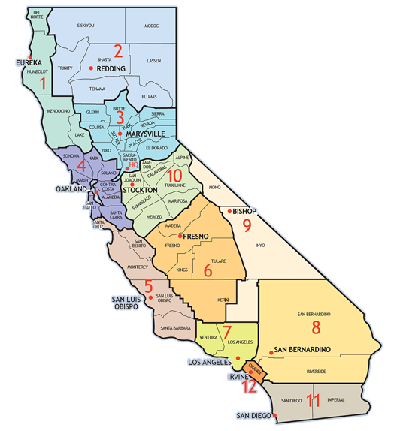
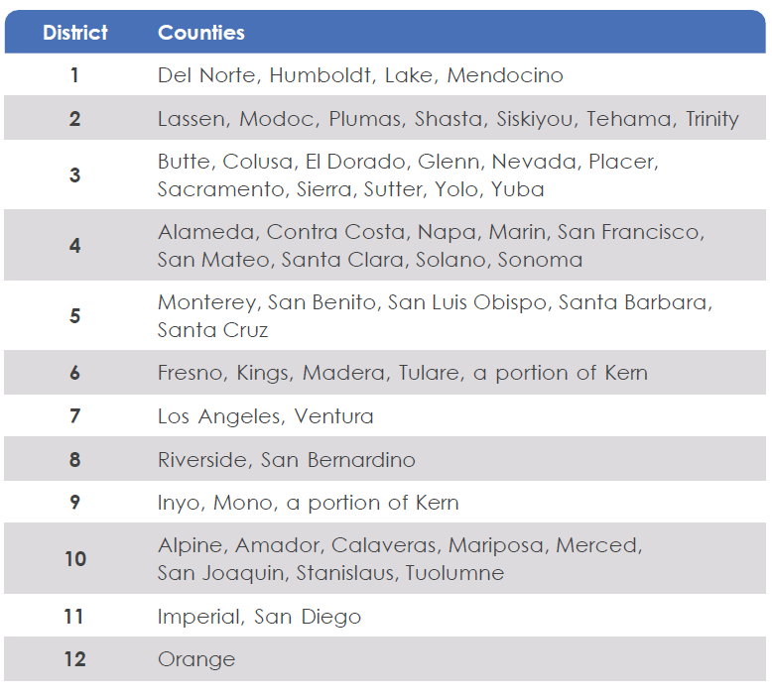
Caltrans Districts
Transit Implementation Focus Groups – Transit Priority Facilities
Caltrans Overview

Slide 8






Transit Implementation Programs
Transit Implementation Focus Groups – Transit Priority Facilities
Caltrans Overview
PLANNING & MODAL PROGRAMS
Division of Local Assistance
PLANNING & MODAL PROGRAMS
Division of Transportation Planning
Office of Transit Grants & Contracts
Office of Project Development, Management & Delivery
Office of Transit Planning
PLANNING & MODAL PROGRAMS
Division of Data & Digital Services
Cal-ITP
Transit Data Quality
Data Services
Division of Traffic Operations
Encroachment permits, multimodal mobility policy, plans, guidance, and project reviews
Caltrans Districts
District Transit Representatives
Corridor Planning

Slide 9
How Transit Projects Get Delivered
Transit Implementation Focus Groups – Transit Priority Facilities
Caltrans Projects
Initiate Project
Construction
Project Approval & Environmental
Develop Plans, Specs & Estimates
Planning
Encroachment Permit Projects
Design Engineering Evaluation Report
(DEER)
Quality Management Assessment Process
(QMAP)
Encroachment Projects
Standard
QMAP
Encroachment Permits Office Projects
(EPOP)

Slide 10
Transit Implementation Plan
Transit Implementation Focus Groups – Transit Priority Facilities

Slide 11
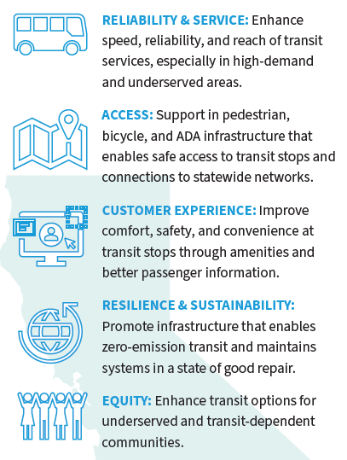

Caltrans District Transit Plans
Transit Implementation Focus Groups – Transit Priority Facilities
Transit Implementation Plan
District Transit Plans will be the basis for an initial list of potential transit projects on the State Highway System that Caltrans could lead.
Staff will work together to develop cost estimates for these projects (including maintenance costs) and will compare that with identified funding.
11

Slide 12
Next Steps
Transit Implementation Focus Groups – Transit Priority Facilities
Transit Implementation Plan
Action | Anticipated Completion Date
Focus Groups | March – April 2026
Transit Implementation Plan Release | Fall 2026
Project Intake Process/Report | January 2027
District Transit Plans | February 2027
Transit Guidance with Performance Metrics | July 2027
12

Slide 13
Focus Group Meetings
Transit Implementation Focus Groups – Transit Priority Facilities

Slide 14
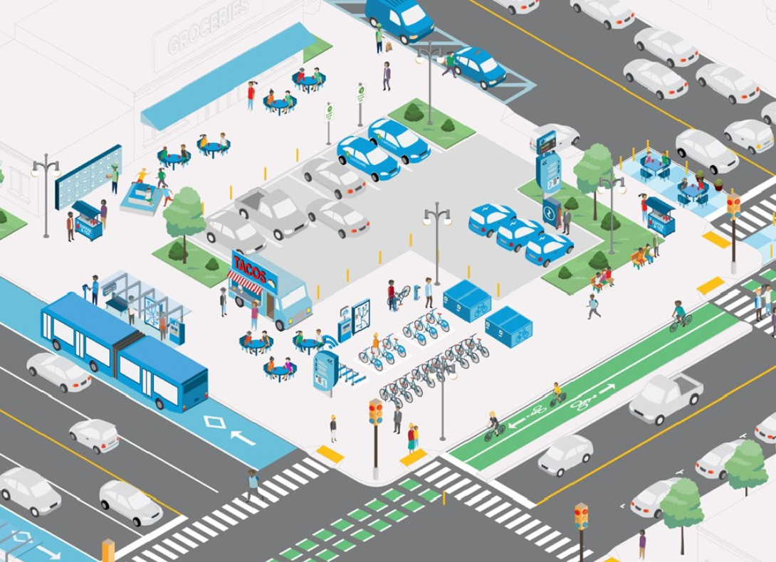
Transit Implementation Focus Groups – Transit Priority Facilities
Focus Group Meeting – Design
Stakeholders
Design
Traffic Operations
Existing design standards for transit
Guidance playbook for transit facilities
Mobility Hub guidance
Bus on Shoulder guidance
Feedback sought
  What deliverables would be most helpful for Design and Ops to produce for partners, and why?
14

Slide 15
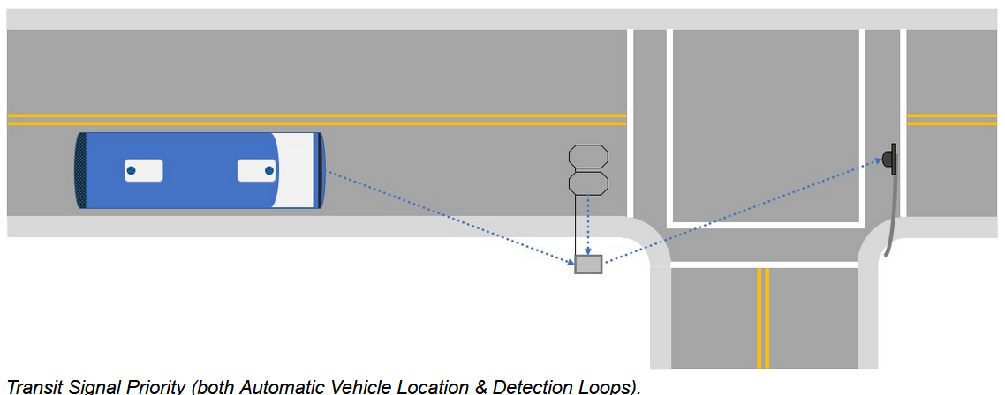
Transit Implementation Focus Groups – Transit Priority Facilities
Focus Group Meeting – Infrastructure and Funding
Stakeholders
Project Management
Asset Management
Local Assistance
Transit priority Caltrans definition and examples
Which transit priority facilities are eligible
  Other potential funding sources for transit facilities
15

Slide 16
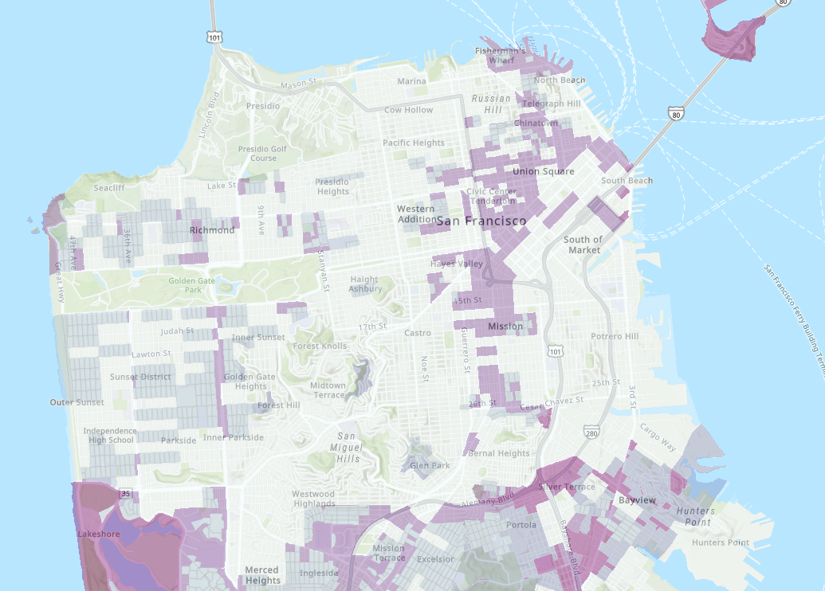
Transit Implementation Focus Groups – Transit Priority Facilities
Focus Group Meeting – Equity
Stakeholders
Equity & Tribal Affairs
Cal-ITP
Data & Digital Services
Community engagement playbook
Equity work at Caltrans
Equity considerations for transit
Ability to provide real-time information in rural areas
16

Slide 17
Transit Implementation Focus Groups – Transit Priority Facilities
Focus Group Meeting – Performance Metrics
District transit plans needs criteria
Survey of transit agencies
Feedback sought
  What transit facilities would partners like Caltrans to prioritize as performance metrics?
  Contributes towards what facilities may be SHOPP eligible
  Intention is to not create metrics Caltrans cannot control
Stakeholders
Data & Digital Services
Asset Management
State Planning
17

Slide 18

Transit Implementation Focus Groups – Transit Priority Facilities
Focus Group Meeting – Maintenance
Stakeholders
Maintenance HQ
Maintenance Districts
Review which transit facilities Caltrans currently maintains.
Consider if there are any new facilities Caltrans would maintain.
Review typical maintenance agreement examples.
Discuss plan to include maintenance funding needs in initial cost estimates.
18

Slide 19

Transit Implementation Focus Groups – Transit Priority Facilities
Focus Group Meeting – Permits
Stakeholders
Traffic Operations
Design
Existing encroachment permit process
SB 960 requirement to report on existing process and annual report to CTC
Provide examples of plans in encroachment permit process
  Where application resources may be accessed
  Best practices for submitting permit applications
19

Slide 20

Caltrans Transit Advisory Committee
Transit Implementation Focus Groups – Transit Priority Facilities
20 external members
Goals
  Input and recommendations on Caltrans guidance and policies
  Provide community-based perspective on transit related challenges or opportunities
  Advise on data collection and best practices to identify and meet transit needs
First meeting TBD Q2 2026
20

Slide 21
Thank You
Transit Implementation Focus Groups – Transit Priority Facilities
Office.of.Transit.Planning@dot.ca.gov

