Slide 1
Transportation Co-op Committee
Dee Lam
May 4, 2026

Slide 2
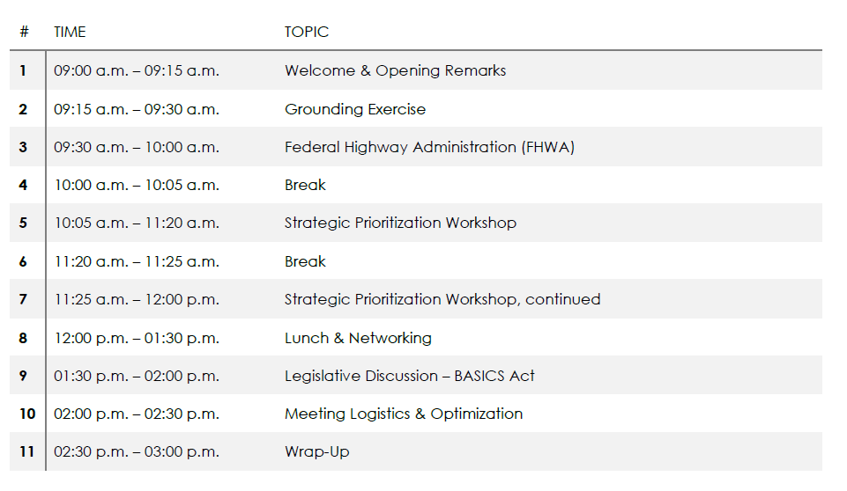
Agenda
Transportation Co-op Committee

Slide 3

Welcome and Housekeeping
Transportation Co-op Committee
Emergency Exits
Bathrooms
Cell Phones
Please ensure you are muted online
Be respectful to the presenter

Slide 4
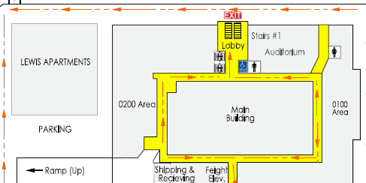
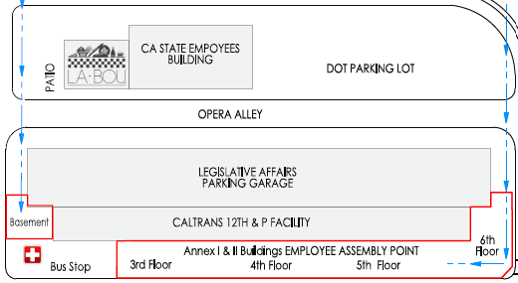
Basement Orientation
Transportation Co-op Committee
EXIT
HERE
Meet here

Slide 5


Opening Remarks
DEE LAM

Slide 6
Grounding Exercise (Rules of Engagement)
Transportation Co-op Committee
Example
Make Space, Take Space
Encourage balanced participation.
• Make Space: Step back when you’ve spoken often; invite others in.
• Take Space: Step forward if you haven’t shared yet—your perspective matters.
Ask questions when something
is unclear.
Summarize what you heard
before responding.
Assume Best Intent, Address Impact
Acknowledge that tone, impact, and
interpretation vary.
Limit Distractions
Approach discussions with a
solutions-oriented mindset

Slide 7
Lets Build Our Rules of Engagement
Transportation Co-op Committee
“Together we can accomplish what none of us can achieve alone”

Slide 8
Federal Highway Administration (FHWA)
May 4, 2026

Slide 9
Break

Slide 10
Strategic Prioritization Workshop
Transportation Co-op Committee
Participants will rotate among themed stations representing Funding, Environmental, Right of Way, Design, Construction
At each station, members will review posted materials, leave written input, react to others’ suggestions, and identify opportunities for improvement. Review, analyze, what's not on it is relevant
Facilitators will consolidate input for a full-group discussion immediately following the rotation.
15 min rotations
Transportation Co-op Committee
Group Leads
Funding- Stacey
Environmental- Danielle
Right of Way- Neidy
Design- Tanzeeba
Construction- Shalini

Slide 11
Break

Slide 12
Strategic Prioritization Workshop
Transportation Co-op Committee
Transportation Co-op Committee
Group Lead Report Out
Funding- Stacey
Environmental- Danielle
Right of Way- Neidy
Design- Tanzeeba
Construction- Shalini

Slide 13

LUNCH AND NETWORKING
Transportation Co-op Committee
12:00 p.m. – 1:30 p.m.

Slide 14
Closing Session: End of Day Agenda
Transportation Co-op Committee
1:30 p.m. – 2:00 p.m. Legislative Discussion – BASICS Act
2:00 p.m. – 2:30 p.m. Meeting Logistics & Optimization
2:30 p.m. – 3:00 p.m. Wrap- up

Slide 15

Closing Remarks
Transportation Co-op Committee
Dee Lam
“Great things in business are never done by one person. They’re done by a team of people.“
Steve Jobs

Slide 16

Thank you
Safe Systems Approach

